Slide 1



Card Game Simulator
Start New Game
Join Game
Card Game Creator
Options
Exit

Slide 2


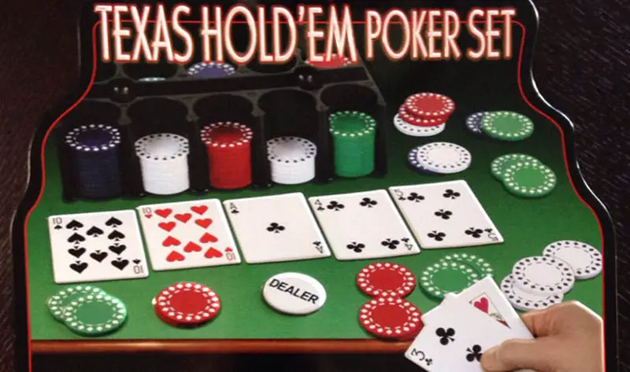

Select a game template:
Taki
Texas Hold’em Poker
Sprint
Monopoly

Slide 3
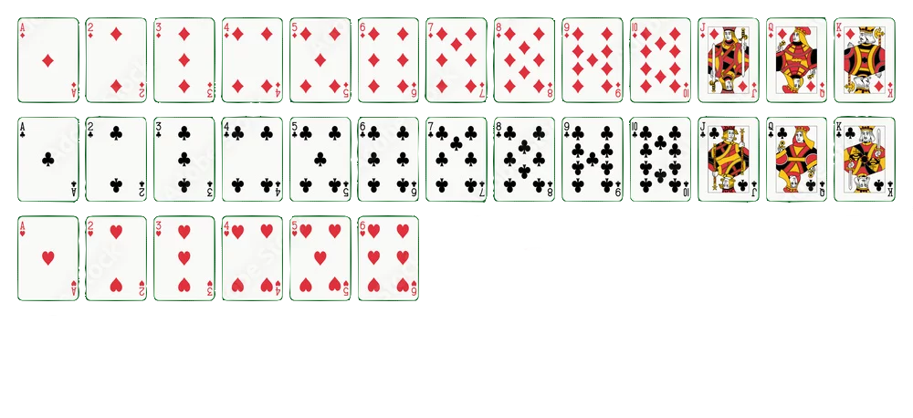



Card Pool
Add card via:

Slide 4
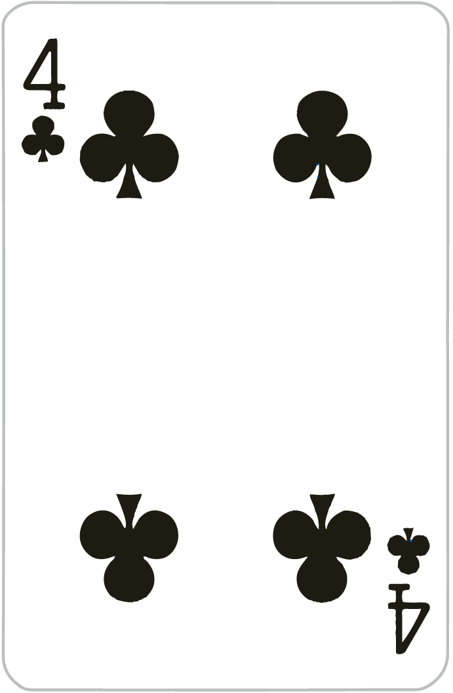
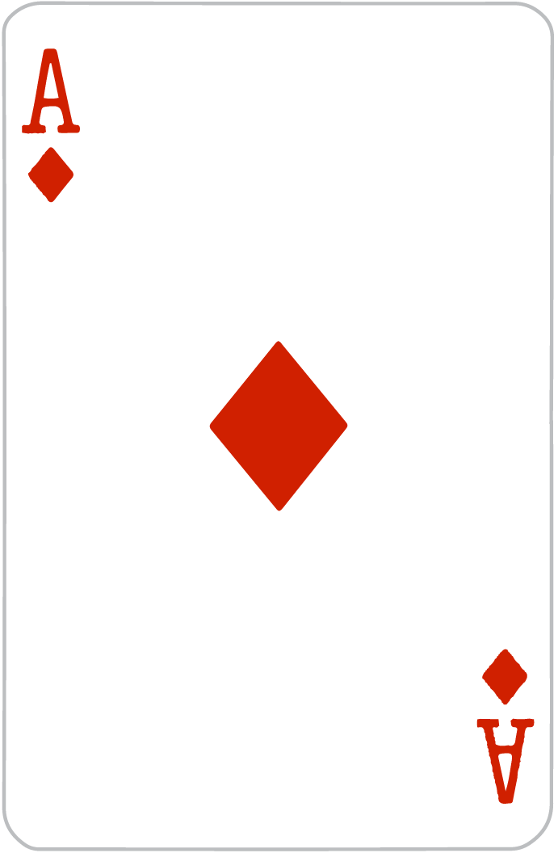
Your Hand:
Place Card
Reveal Card
Select Additional Cards
Chatrooms
Look at Table
Cancel Selection

Slide 5
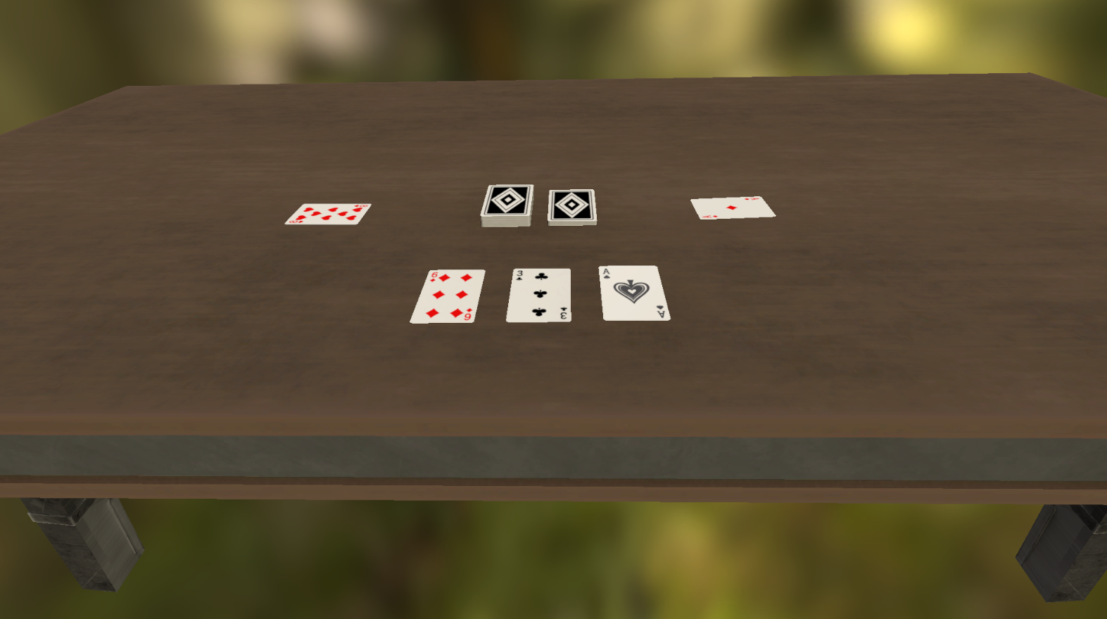




Return To Hand
Chatrooms
Player 1 Score:
20
Player 2 Score:
40
Player 3 Score:
20
Player 4 Score:
100

Slide 6

Joining Game...
A Game Has Been Found!
Game Name: Taki
Join Game

Slide 7
Asset Sources:
Button asset by pauboeg:
https://pauboeg.itch.io/ui-starter-pack
Wooden PBR Table by Intercido:
https://assetstore.unity.com/packages/3d/props/wooden-pbr-table-112005
Free Playing Cards Pack by Game Asset Studio:
https://assetstore.unity.com/packages/3d/props/tools/free-playing-cards-pack-154780

